Slide 1
Recursion: The Mirrors
Chapter 2
© 2017 Pearson Education, Hoboken, NJ. All rights reserved

Slide 2
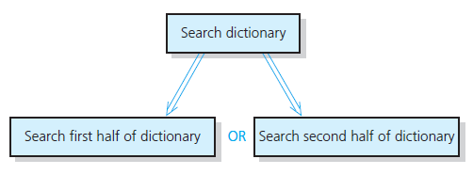
Recursive Solutions
Recursion breaks problem into smaller identical problems
  An alternative to iteration
FIGURE 2-1 A recursive solution
© 2017 Pearson Education, Hoboken, NJ. All rights reserved
Notes:
Recursion is basically when a function calls itself

Slide 3
Recursive Solutions
A recursive function calls itself
Each recursive call solves an identical, but smaller, problem
Test for base case enables recursive calls to stop
Eventually, one of smaller problems must be the base case
© 2017 Pearson Education, Hoboken, NJ. All rights reserved

Slide 4
Recursive Solutions
Questions for constructing recursive solutions
How to define the problem in terms of a smaller problem of same type?
How does each recursive call diminish the size of the problem?
What instance of problem can serve as base case?
As problem size diminishes, will you reach base case?
© 2017 Pearson Education, Hoboken, NJ. All rights reserved
Notes:
Recursion does have a limit; you can blow the stack depth and thus not be able to do it

Slide 5
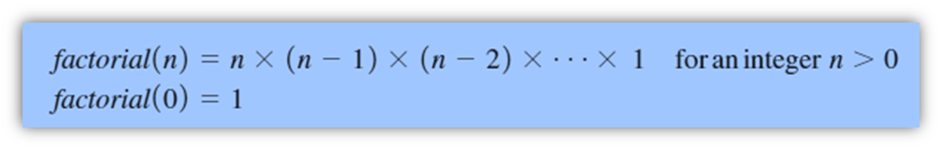
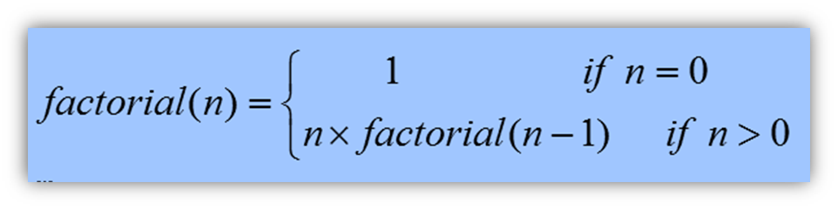
A Recursive Valued Function:
The Factorial of n
An iterative solution
A factorial solution
Note: Do not use
recursion if a
problem has a
simple, efficient
iterative solution
© 2017 Pearson Education, Hoboken, NJ. All rights reserved

Slide 6
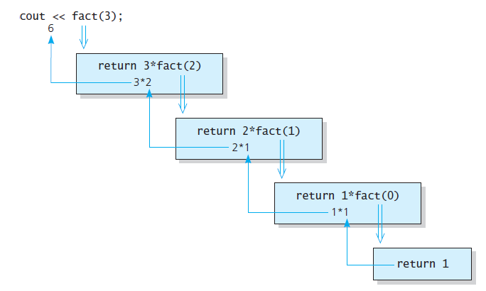
A Recursive Valued Function:
The Factorial of n
FIGURE 2-2 fact(3)
© 2017 Pearson Education, Hoboken, NJ. All rights reserved

Slide 7
The Box Trace
Label each recursive call
Represent each call to function by a new box
Draw arrow from box that makes call to newly created box
After you create new box executing body of function
On exiting function, cross off current box and follow its arrow back
© 2017 Pearson Education, Hoboken, NJ. All rights reserved

Slide 8
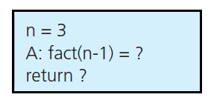
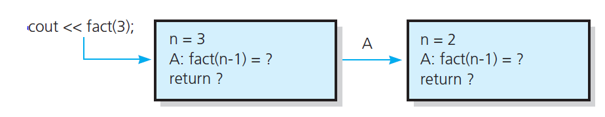
The Box Trace
FIGURE 2-3 A box
FIGURE 2-4 The beginning of the box trace
© 2017 Pearson Education, Hoboken, NJ. All rights reserved

Slide 9
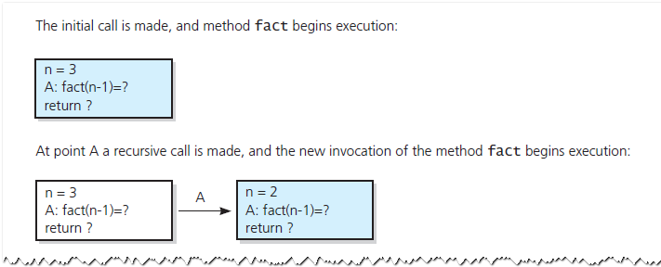
The Box Trace
FIGURE 2-5 Box trace of fact(3)
© 2017 Pearson Education, Hoboken, NJ. All rights reserved

Slide 10
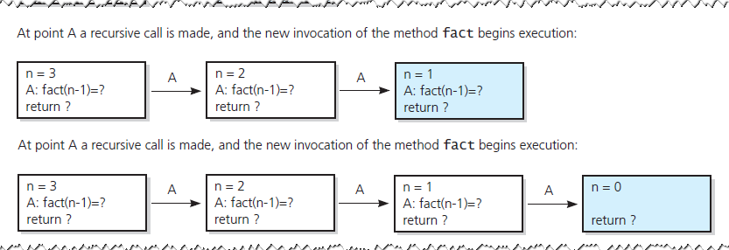
The Box Trace
FIGURE 2-5 Box trace of fact(3)
© 2017 Pearson Education, Hoboken, NJ. All rights reserved

Slide 11
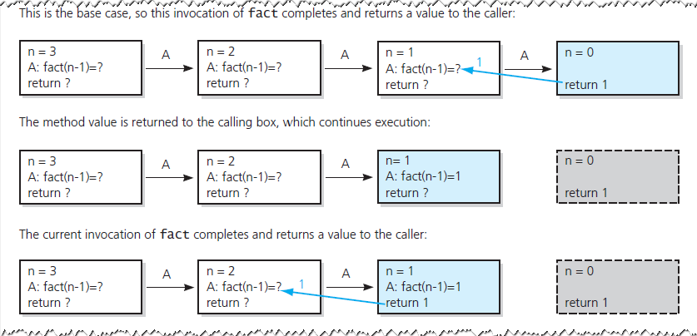
The Box Trace
FIGURE 2-5 Box trace of fact(3)
© 2017 Pearson Education, Hoboken, NJ. All rights reserved

Slide 12
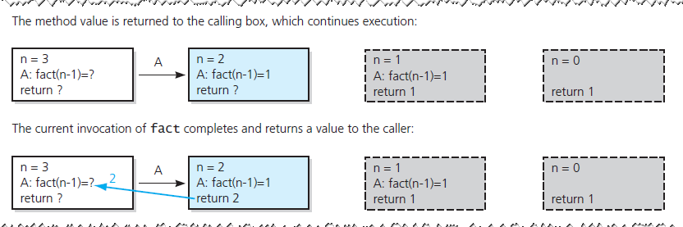
The Box Trace
FIGURE 2-5 Box trace of fact(3)
© 2017 Pearson Education, Hoboken, NJ. All rights reserved

Slide 13
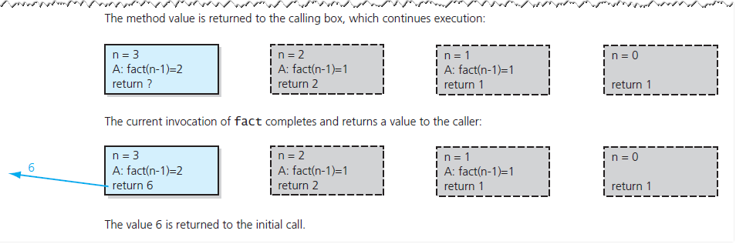
The Box Trace
FIGURE 2-5 Box trace of fact(3)
© 2017 Pearson Education, Hoboken, NJ. All rights reserved

Slide 14
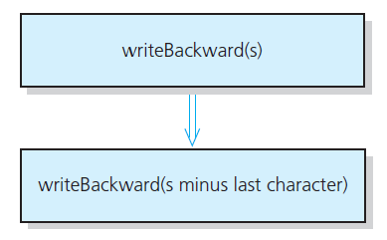
A Recursive Void Function:
Writing a String Backward
Likely candidate for minor task is writing a single character.
  Possible solution: strip away the last character
FIGURE 2-6 A recursive solution
© 2017 Pearson Education, Hoboken, NJ. All rights reserved

Slide 15
Stop here for Week 2 topics
© 2017 Pearson Education, Hoboken, NJ. All rights reserved

Slide 16
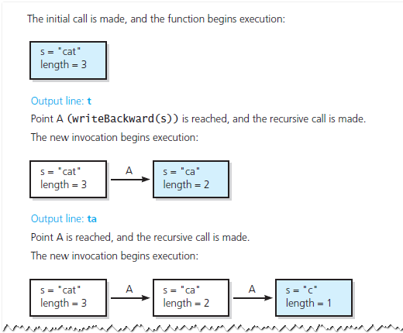
A Recursive Void Function:
Writing a String Backward
FIGURE 2-7 Box trace of writeBackward("cat")
© 2017 Pearson Education, Hoboken, NJ. All rights reserved

Slide 17
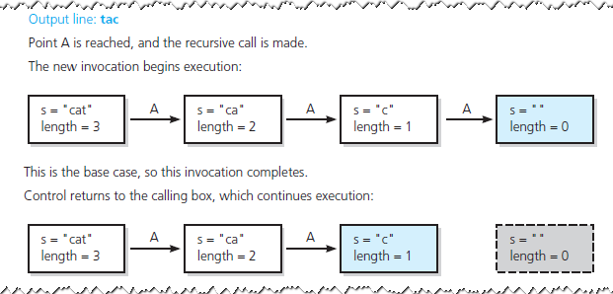
A Recursive Void Function:
Writing a String Backward
FIGURE 2-7 Box trace of writeBackward("cat")
© 2017 Pearson Education, Hoboken, NJ. All rights reserved

Slide 18
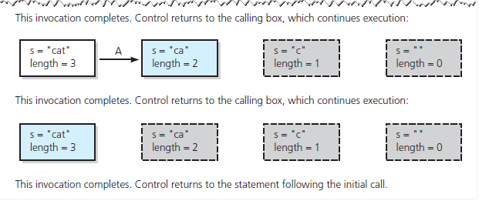
A Recursive Void Function:
Writing a String Backward
FIGURE 2-7 Box trace of writeBackward("cat")
© 2017 Pearson Education, Hoboken, NJ. All rights reserved

Slide 19
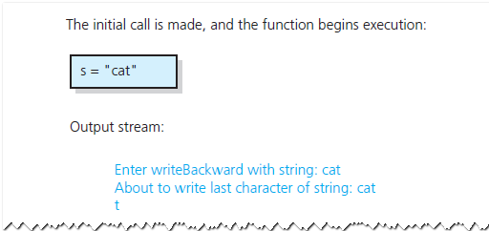
A Recursive Void Function:
Writing a String Backward
Another possible solution
  Strip away the first character
FIGURE 2-8 Box trace of writeBackward("cat") in pseudocode
© 2017 Pearson Education, Hoboken, NJ. All rights reserved

Slide 20
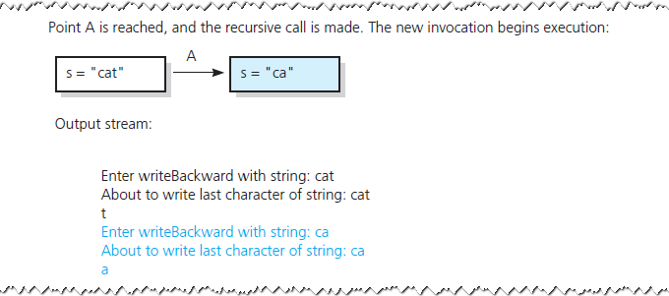
A Recursive Void Function:
Writing a String Backward
FIGURE 2-8 Box trace of writeBackward("cat") in pseudocode
© 2017 Pearson Education, Hoboken, NJ. All rights reserved

Slide 21
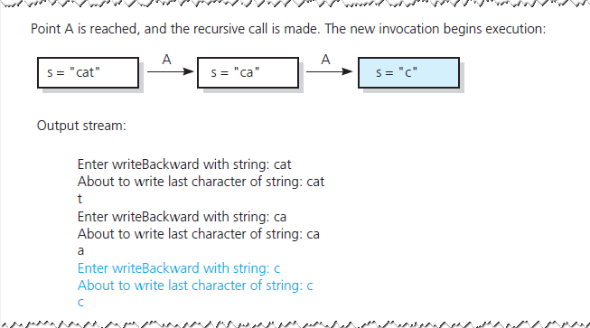
A Recursive Void Function:
Writing a String Backward
FIGURE 2-8 Box trace of writeBackward("cat") in pseudocode
© 2017 Pearson Education, Hoboken, NJ. All rights reserved

Slide 22
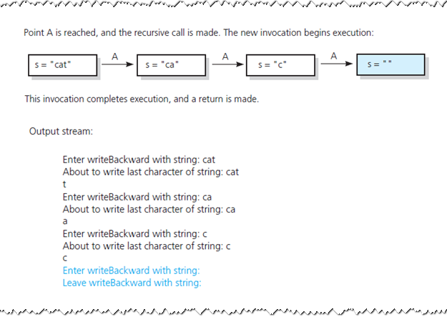
A Recursive Void Function:
Writing a String Backward
FIGURE 2-8 Box trace of writeBackward("cat") in pseudocode
© 2017 Pearson Education, Hoboken, NJ. All rights reserved

Slide 23
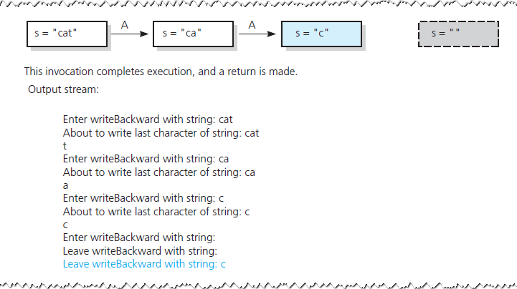
A Recursive Void Function:
Writing a String Backward
FIGURE 2-8 Box trace of writeBackward("cat") in pseudocode
© 2017 Pearson Education, Hoboken, NJ. All rights reserved

Slide 24
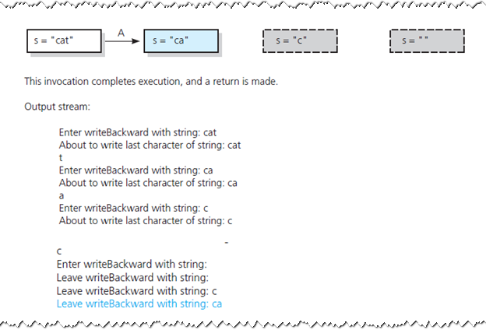
A Recursive Void Function:
Writing a String Backward
FIGURE 2-8 Box trace of writeBackward("cat") in pseudocode
© 2017 Pearson Education, Hoboken, NJ. All rights reserved

Slide 25
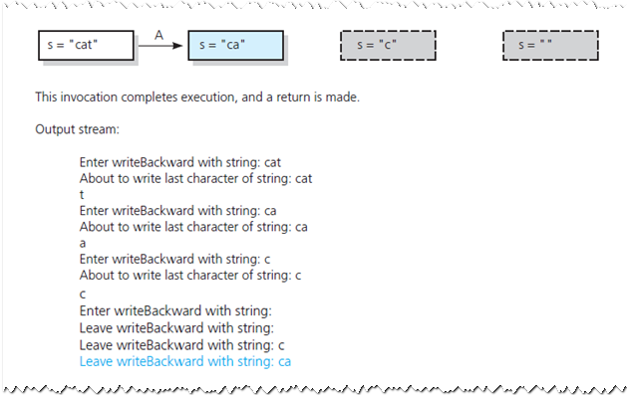
A Recursive Void Function:
Writing a String Backward
FIGURE 2-8 Box trace of writeBackward("cat") in pseudocode
© 2017 Pearson Education, Hoboken, NJ. All rights reserved

Slide 26
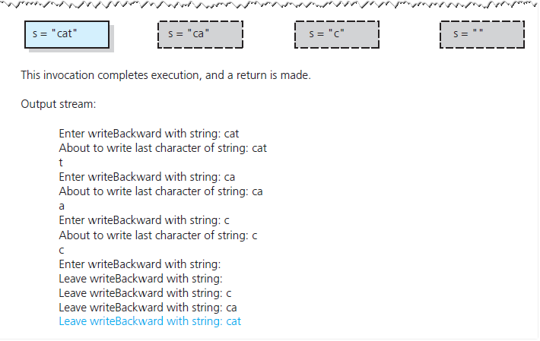
A Recursive Void Function:
Writing a String Backward
FIGURE 2-8 Box trace of writeBackward("cat") in pseudocode
© 2017 Pearson Education, Hoboken, NJ. All rights reserved

Slide 27
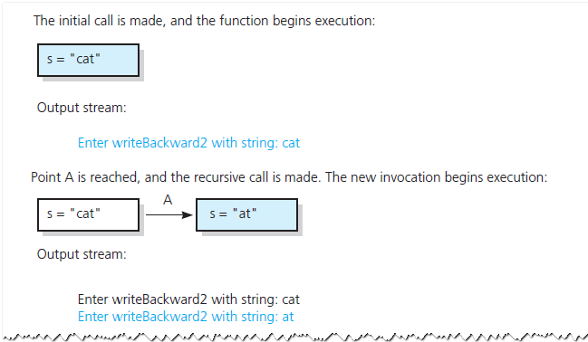
A Recursive Void Function:
Writing a String Backward
FIGURE 2-8 Box trace of writeBackward2("cat") in pseudocode
© 2017 Pearson Education, Hoboken, NJ. All rights reserved

Slide 28
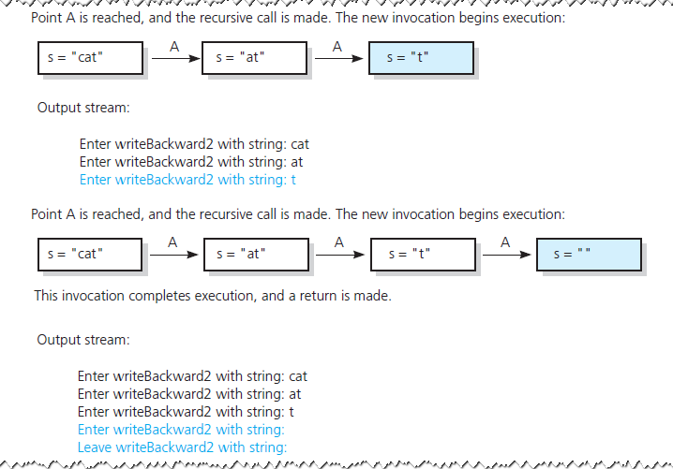
A Recursive Void Function:
Writing a String Backward
FIGURE 2-8 Box trace of writeBackward2("cat") in pseudocode
© 2017 Pearson Education, Hoboken, NJ. All rights reserved

Slide 29
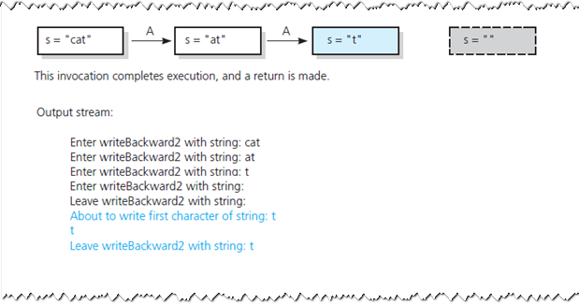
A Recursive Void Function:
Writing a String Backward
FIGURE 2-8 Box trace of writeBackward2("cat") in pseudocode
© 2017 Pearson Education, Hoboken, NJ. All rights reserved

Slide 30
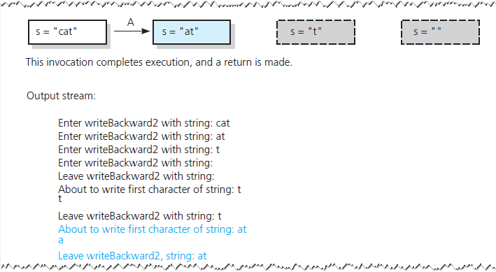
A Recursive Void Function:
Writing a String Backward
FIGURE 2-8 Box trace of writeBackward2("cat") in pseudocode
© 2017 Pearson Education, Hoboken, NJ. All rights reserved

Slide 31
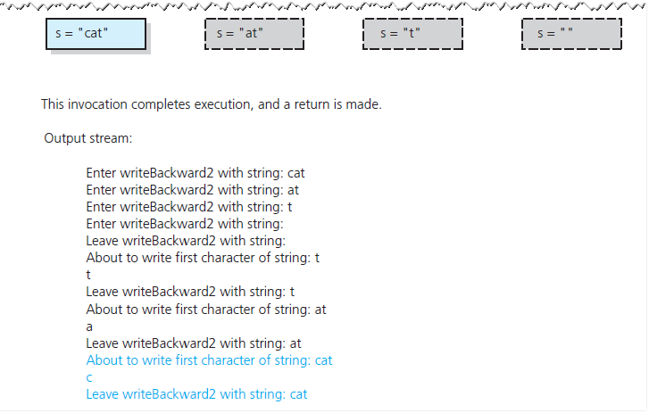
A Recursive Void Function:
Writing a String Backward
FIGURE 2-8 Box trace of writeBackward2("cat") in pseudocode
© 2017 Pearson Education, Hoboken, NJ. All rights reserved

Slide 32
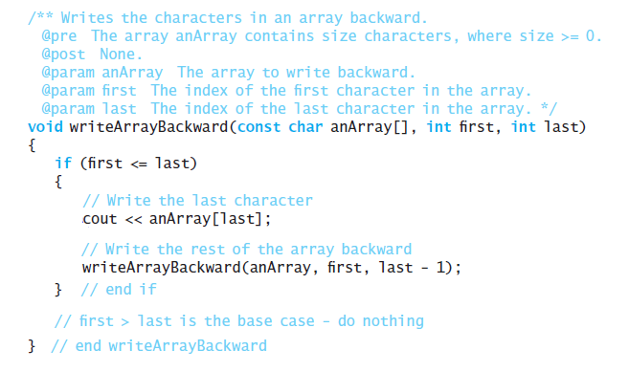
Writing an Array’s Entries in Backward Order
The function writeArrayBackward
© 2017 Pearson Education, Hoboken, NJ. All rights reserved

Slide 33
The Binary Search
Consider details before implementing algorithm:
How to pass half of anArray to recursive calls of binarySearch ?
How to determine which half of array contains target?
What should base case(s) be?
How will binarySearch indicate result of search?
© 2017 Pearson Education, Hoboken, NJ. All rights reserved

Slide 34
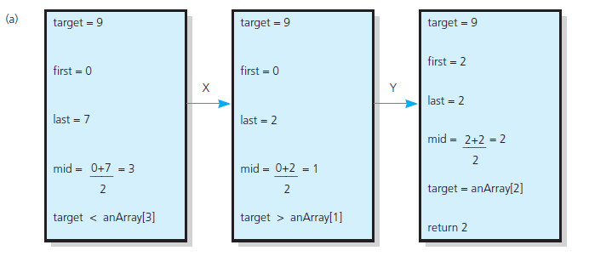
The Binary Search
FIGURE 2-10 Box traces of binarySearch with anArray = <1, 5, 9, 12, 15, 21, 29, 31>: (a) a successful search for 9;
© 2017 Pearson Education, Hoboken, NJ. All rights reserved

Slide 35
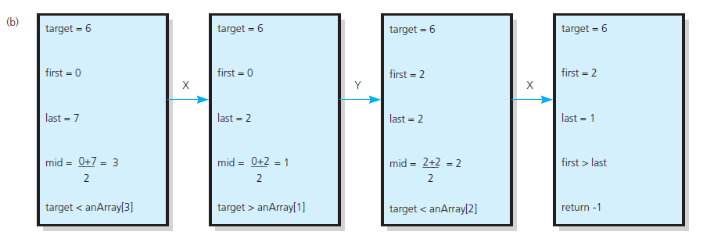
The Binary Search
FIGURE 2-10 Box traces of binarySearch with anArray = <1, 5, 9, 12, 15, 21, 29, 31>: (b) an unsuccessful search for 6
© 2017 Pearson Education, Hoboken, NJ. All rights reserved

Slide 36
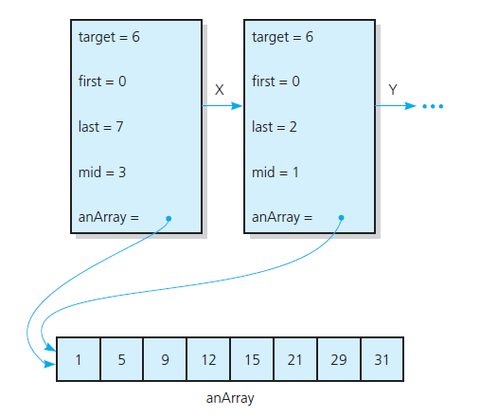
The Binary Search
FIGURE 2-11 Box trace with a reference argument
© 2017 Pearson Education, Hoboken, NJ. All rights reserved

Slide 37
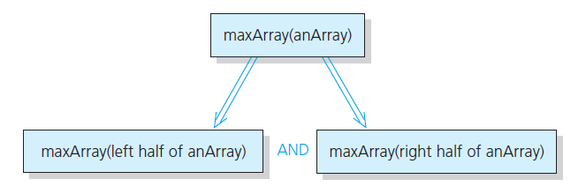
Finding the Largest Value in an Array
FIGURE 2-12 Recursive solution to the largest-value problem
© 2017 Pearson Education, Hoboken, NJ. All rights reserved

Slide 38
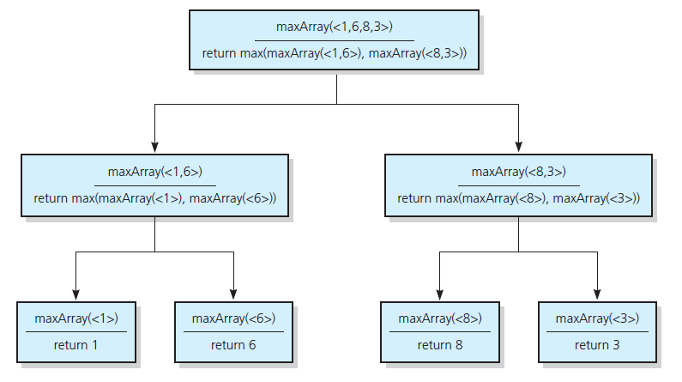
Finding the Largest Value in an Array
FIGURE 2-13 The recursive calls
that maxArray(<1,6,8,3>) generates
© 2017 Pearson Education, Hoboken, NJ. All rights reserved

Slide 39
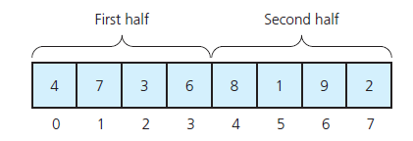
Finding k^{th} Smallest Value of Array
Recursive solution proceeds by:
Selecting pivot value in array
Cleverly arranging/ partitioning values in array about pivot value
Recursively applying strategy to one of partitions
FIGURE 2-14 A sample array
© 2017 Pearson Education, Hoboken, NJ. All rights reserved

Slide 40
Finding k^{th} Smallest Value of Array
FIGURE 2-15 A partition about a pivot
© 2017 Pearson Education, Hoboken, NJ. All rights reserved

Slide 41
The Towers of Hanoi
The problem statement
  Beginning with n disks on pole A and zero disks on poles B and C, solve towers(n, A, B, C) .
Solution
  With all disks on A, solve towers(n – 1, A, C, B)
  With the largest disk on pole A and all others on pole C, solve towers(n – 1, A, B, C)
  With the largest disk on pole B and all the other disks on pole C, solve towers(n – 1, C, B, A)
© 2017 Pearson Education, Hoboken, NJ. All rights reserved

Slide 42
The Towers of Hanoi
FIGURE 2-16 (
© 2017 Pearson Education, Hoboken, NJ. All rights reserved

Slide 43
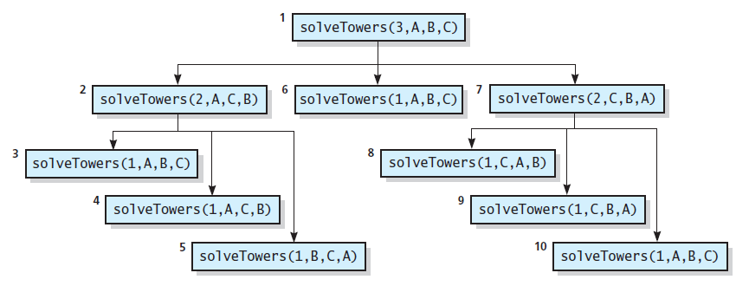
The Towers of Hanoi
FIGURE 2-17 The order of recursive calls that
results from solveTowers(3, A, B, C)
© 2017 Pearson Education, Hoboken, NJ. All rights reserved

Slide 44
The Fibonacci Sequence (Multiplying Rabbits)
Assume the following “facts” …
Rabbits never die.
Rabbit reaches sexual maturity at beginning of third month of life.
Rabbits always born in male-female pairs. At beginning of every month, each sexually mature male-female pair gives birth to exactly one male-female pair.
© 2017 Pearson Education, Hoboken, NJ. All rights reserved

Slide 45
The Fibonacci Sequence (Multiplying Rabbits)
Monthly sequence
One pair, original two rabbits
One pair still
Two pairs (original pair, two newborns)
Three pairs (original pair, 1 month old, newborns)
Five pairs …
Eight pairs …
© 2017 Pearson Education, Hoboken, NJ. All rights reserved

Slide 46
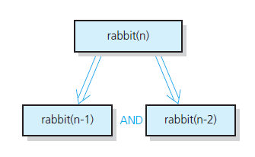
The Fibonacci Sequence (Multiplying Rabbits)
FIGURE 2-18 Recursive solution to the rabbit problem
(number of pairs at month n)
© 2017 Pearson Education, Hoboken, NJ. All rights reserved

Slide 47
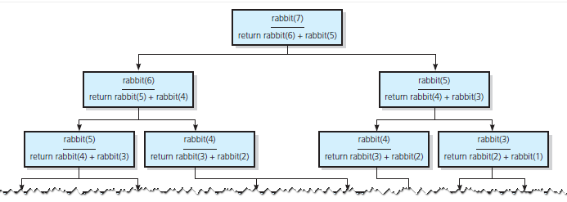
The Fibonacci Sequence (Multiplying Rabbits)
F IGURE 2-19 The recursive calls that rabbit(7) generates
© 2017 Pearson Education, Hoboken, NJ. All rights reserved

Slide 48
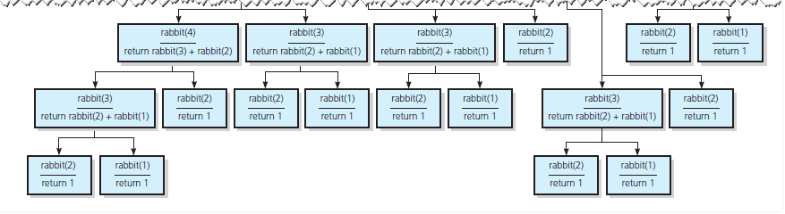
The Fibonacci Sequence (Multiplying Rabbits)
F IGURE 2-19 The recursive calls that rabbit(7) generates
© 2017 Pearson Education, Hoboken, NJ. All rights reserved

Slide 49
Organizing a Parade
Will consist of bands and floats in single line.
  You are asked not to place one band immediately after another
In how many ways can you organize a parade of length n ?
  P (n) = number of ways to organize parade of length n
  F (n) = number of parades of length n, end with a float
  B (n) = number of parades of length n, end with a band
Then P(n) = F(n) + B(n)
© 2017 Pearson Education, Hoboken, NJ. All rights reserved

Slide 50
Organizing a Parade
Possible to see
  P(1) = 2
  P (2) = 3
  P (n) = P(n – 1) + P(n – 2) for n > 2
Thus a recursive solution
  Solve the problem by breaking up into cases
© 2017 Pearson Education, Hoboken, NJ. All rights reserved

Slide 51

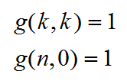
Choosing k Out of n Things
Rock band wants to tour k out of n cities
  Order not an issue
Let g( n, k ) be number of groups of k cities chosen from n
Base cases
© 2017 Pearson Education, Hoboken, NJ. All rights reserved

Slide 52
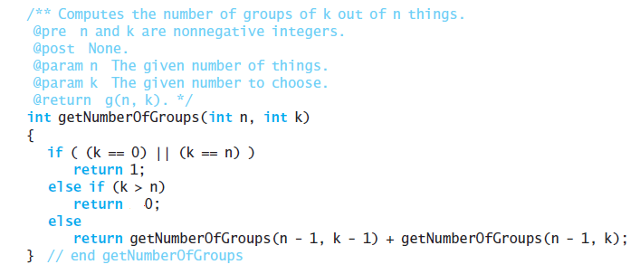
Choosing k Out of n Things
Function for recursive solution.
© 2017 Pearson Education, Hoboken, NJ. All rights reserved

Slide 53
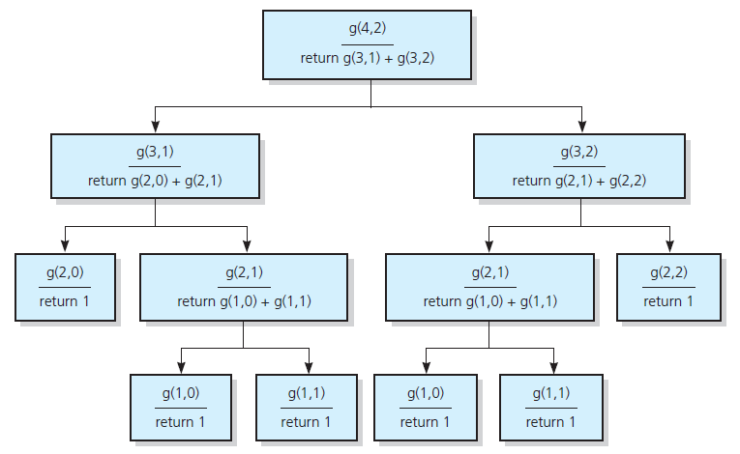
Choosing k Out of n Things
FIGURE 2-20 The recursive calls that g (4, 2) generates
© 2017 Pearson Education, Hoboken, NJ. All rights reserved

Slide 54
Recursion and Efficiency
Factors that contribute to inefficiency
  Overhead associated with function calls
  Some recursive algorithms inherently inefficient
Keep in mind
  Recursion can clarify complex solutions … but …
  Clear, efficient iterative solution may be better
© 2017 Pearson Education, Hoboken, NJ. All rights reserved

Slide 55
End
Chapter 2
© 2017 Pearson Education, Hoboken, NJ. All rights reserved

